Slide 1
Strategic Management
Understanding the Competitive Environment & Strategic Capabilities
Week 3
MG 5596
Dr. Ainurul Rosli

Slide 2
Macro-environment
Scenario planning
Micro-environment
5-forces
Strategic groups
Internal environment
Value chain
Strategic capabilities-VRIN
PESTLE/
STEPWISE
Notes:
Scenario planning
Strategic group: organisation within the industry with similar strategic characteristics, following similar strategies or competing on similar bases.

Slide 3
Session 3: Learning Outcomes
Micro environmental Analysis & Strategic capabilities
01
02
03
04
WHY
WHAT
HOW
IMPACT
Understand how the structural features of an industry influence competition and profitability
Identify strategic capabilities in terms of organisational resources and competences
Porter’s five forces;
VRIO
how these relate to the strategies of organisations
Identify strategic capabilities in terms of organisational resources and competences and how these relate to the strategies of organisations
Analyse how strategic capabilities might provide sustainable competitive advantage on the basis of their Value, Rarity, Inimitability and Organisational support (VRIO).

Slide 4
Overview
Business Environment
PESTEL
SCANSTEP
Industry Environment
Porter’s 5 forces
Firm
Recourses & Capabilities
4

Slide 5
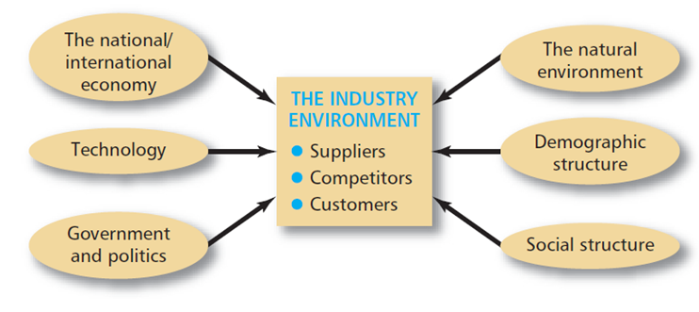
Business Environment
Formed by relationship between:
Customers, suppliers and competitors
i.e. industry’s environment
Essential to link environmental analysis to industry analysis
Use PEST(LE) & Porters 5 Forces

Slide 6
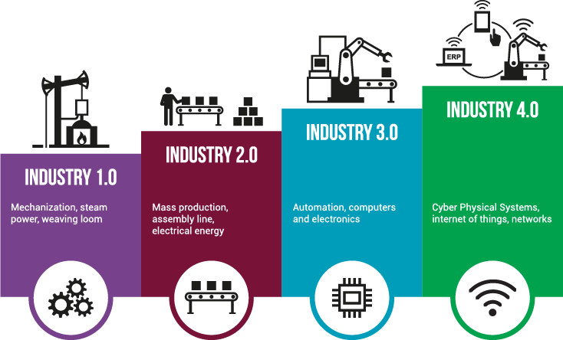
What is an Industry?

Slide 7
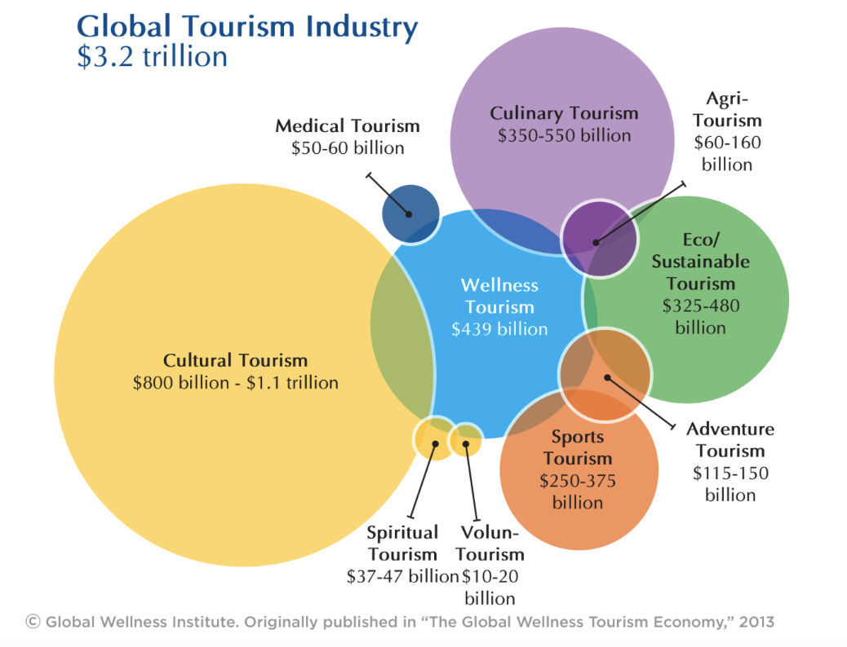
How are industries defined?
Notes:
Products in the industry are functionally similar.
Example: Air conditioners cool the air in a building in a functionally similar way that is different from a fan, which is a substitute.
Products in the industry compete directly by influencing demand.
Changes in the value or price of a firm’s product affect demand for competing firms’ products.

Slide 8
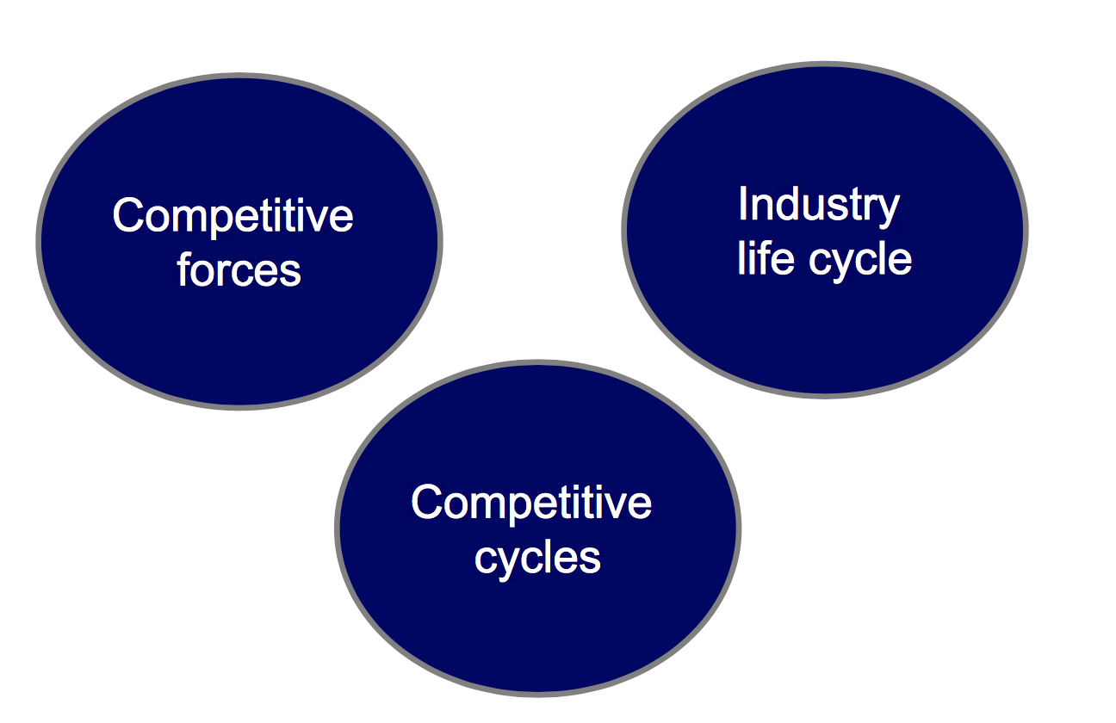
Why do we need to do industry analysis?
Assessing industry attractiveness
Notes:
Firms whose products provide value in functionally equivalent ways.
Firms that compete directly through changes in product value and price.
Firms that face the same common factors of economic interdependence in an industry.
Identifying substitute producers
Firms whose products are functionally different from an industry’s products but compete to provide value to the same industry buyers.

Slide 9
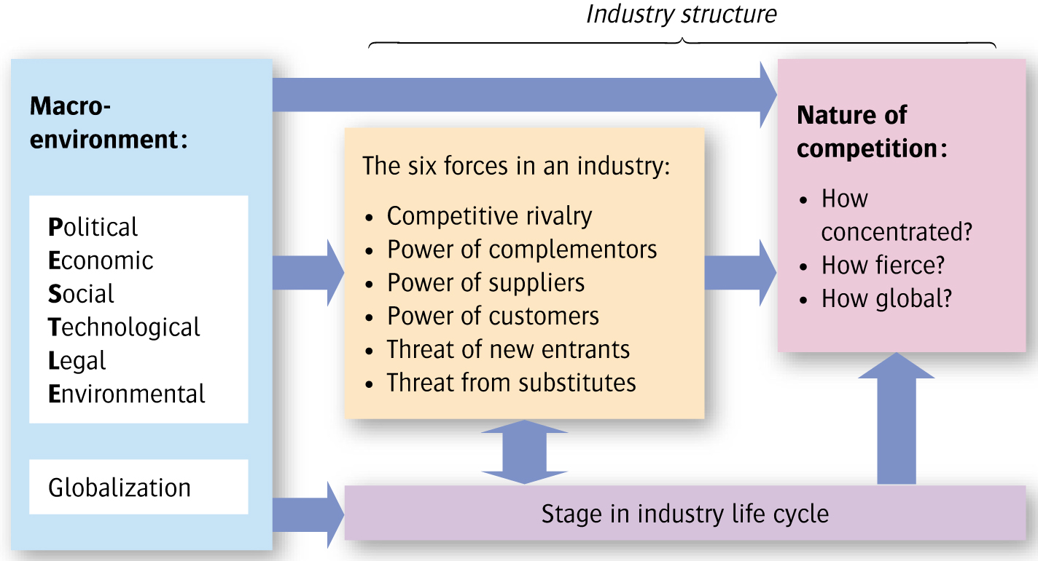
Analysing the nature of competition
Haberberg & Rieple 2008

Slide 10

Key drivers of change
Key drivers for change:
The environmental factors likely to have a high impact on the success or failure of strategy.
Typically key drivers vary by industry or market.
For example, retailers are concerned with social changes and customer behaviour which have driven a move to ‘out of town’ shopping. Personal disposable income also drives demand for retailers.

Slide 11
Judging whether two related products come from the same industry
Are inputs and product technologies similar?
Are competitors mostly the same?
Do firms look to the same resources as the basis of competitive advantage, and have broadly similar value chains?
Is there significant overlap between the different products’ customers and end-users?
Firms in an industry also share a ‘recipe’:
Shared mental model; ‘rules of the game’
Common routines

Slide 12
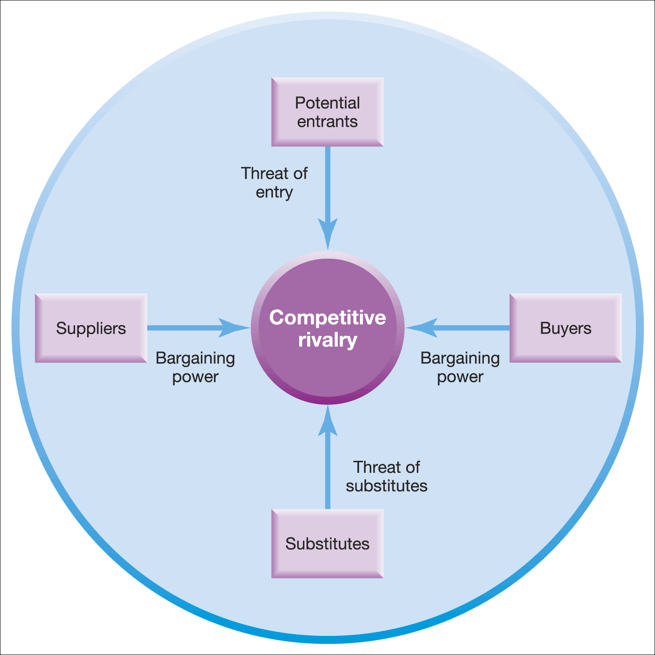

Porters
5 Forces Framework
Understanding the structure of an industry and its attractiveness
Forces Influencing Firms Performance
Help to determine average rate of return for the firms in an industry
Source: Adapted with the permission of The Free Press, a Division of Simon & Schuster Adult Publishing Group, from Competitive Strategy: Techniques for Analyzing Industries and Competitors by Michael E. Porter. Copyright © 1980, 1998 by The Free Press. All rights reserved
Notes:
five forces are high and strong, industries are not attractive.

Slide 13

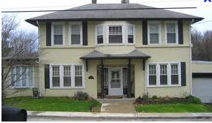
Threat of new entrants
Barriers to entry : Condition that creates a disincentive for a new firm to enter an industry
How easy it is to enter the industry influences the degree of competition.
The greater the threat of entry, the worse it is for incumbents in an industry
Notes:
Attract new entrants due to structural changes which have lowered barriers (regulation/political)
Industry moved to one characterised by specialist providers (unbundling by large conglomerates)
Cost structures changed
companies in Far East have
lower factor costs
low manufacturing costs
Overall force strength: High

Slide 14
Threat of Entry
Scale and experience
Access to supply and distribution channels
Expected retaliation
Legislation or government action
Differentiation
Notes:
What Factors Raise Entry Barriers? High barriers to imitation
Property rights
Dedicated assets
Causal ambiguity
Learning curve and development costs
High customer switching costs
Lower prices by firms in the industry
Limit pricing

Slide 15
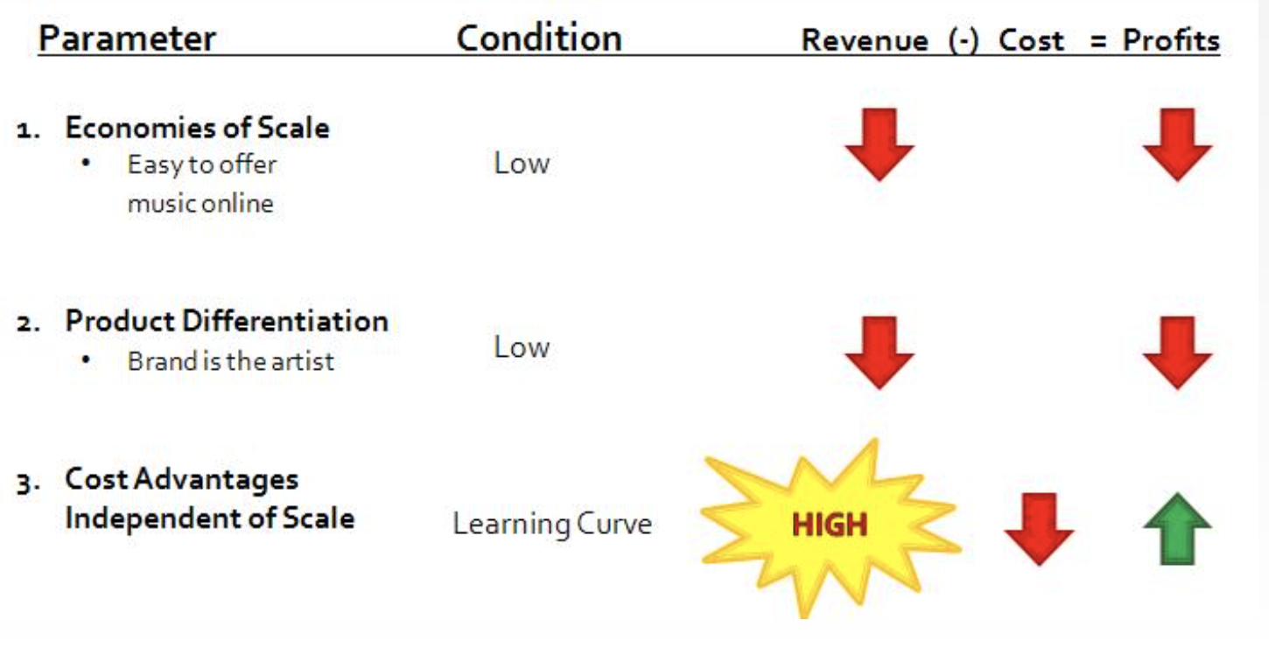
Threat of Entry: Music Industry
Notes:
Sources: http://schmidke330.wikidot.com/threat-of-entry
The UK is a music powerhouse, with exports of £2.5bn last year
Barriers to entry include:
Brand loyalty: Customers in the industry show a strong preference for the products and/or services of existing companies.
Cost advantages: Existing companies can easily produce and offer its products and/or services at a lower cost/price than that of new entrants.
Government regulations
Capital requirement: A high fixed cost to enter into an industry, i.e. telecommunications.
Access to suppliers and distribution channels: Existing companies own exclusive rights to suppliers and distribution channels.
Retaliation: Existing companies may collude and deter new entrants.

Slide 16
Threat of Substitutes
The presence of substitute products can lower industry attractiveness and profitability because they limit price levels.
The threat of substitute products depends on:
- Buyers' willingness to substitute - The relative price and performance of substitutes - The costs of switching to substitutes
Notes:
What Factors Raise Entry Barriers? High barriers to imitation
Property rights
Dedicated assets
Causal ambiguity
Learning curve and development costs
High customer switching costs
Lower prices by firms in the industry
Limit pricing

Slide 17
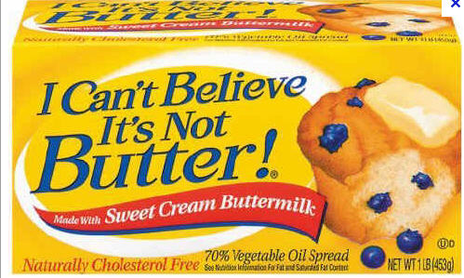
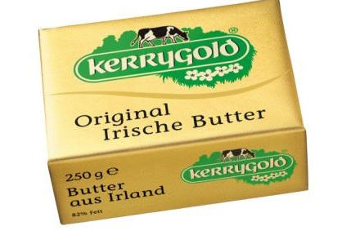
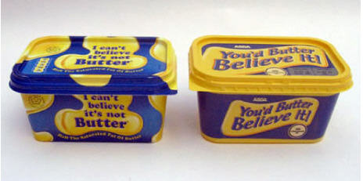
Why substitute products can limit price level?
Important points to bear in mind about substitutes
The price/performance ratio
Extra-industry effects
Notes:
If the buyers’ switching costs for the substitute are low the threat increases and the higher the threat, the less attractive the industry is likely to be.

Slide 18
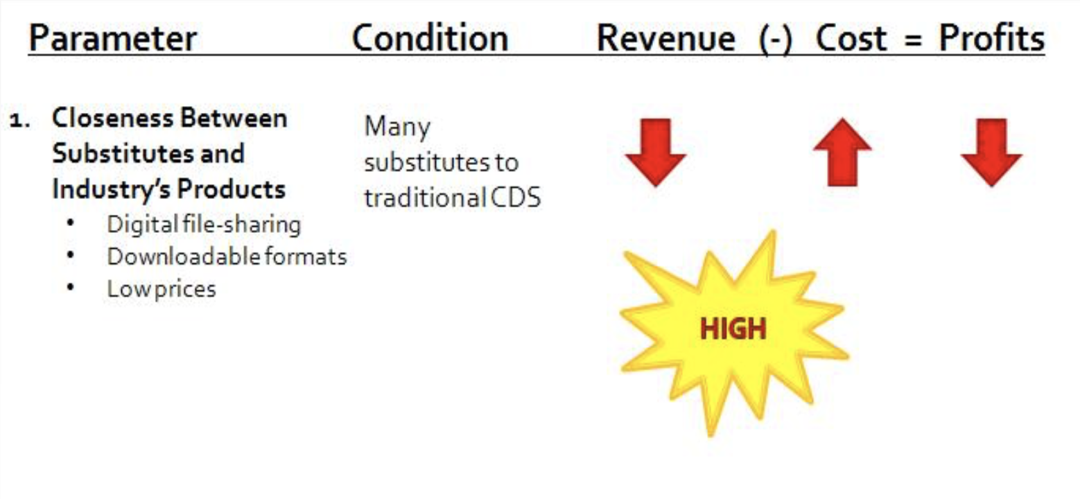
Threat of Substitutes: Music Industry
Notes:
Sources: http://schmidke330.wikidot.com/threat-of-entry
The UK is a music powerhouse, with exports of £2.5bn last year
Barriers to entry include:
Brand loyalty: Customers in the industry show a strong preference for the products and/or services of existing companies.
Cost advantages: Existing companies can easily produce and offer its products and/or services at a lower cost/price than that of new entrants.
Government regulations
Capital requirement: A high fixed cost to enter into an industry, i.e. telecommunications.
Access to suppliers and distribution channels: Existing companies own exclusive rights to suppliers and distribution channels.
Retaliation: Existing companies may collude and deter new entrants.

Slide 19
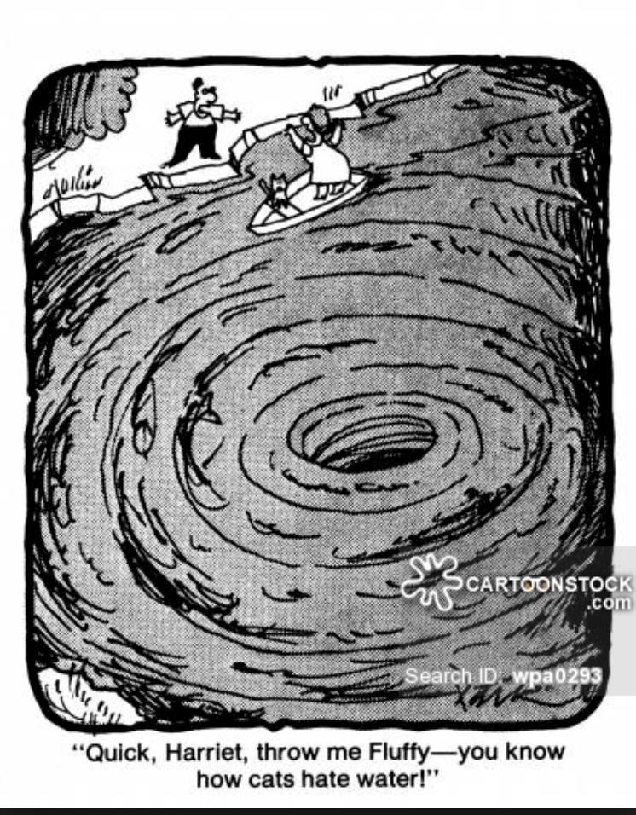
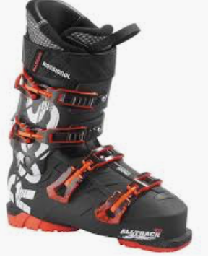
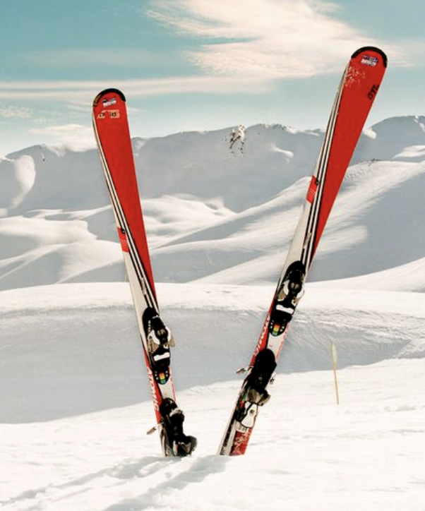
What are complements?
Are products, not in the same industry, whose patterns of demand are systematically positively correlated and move in tandem.
Create a reciprocal expansion of demand.
Network effect and
strategic ‘lock-in’
Notes:
Sources: http://schmidke330.wikidot.com/threat-of-entry
The UK is a music powerhouse, with exports of £2.5bn last year
Barriers to entry include:
Brand loyalty: Customers in the industry show a strong preference for the products and/or services of existing companies.
Cost advantages: Existing companies can easily produce and offer its products and/or services at a lower cost/price than that of new entrants.
Government regulations
Capital requirement: A high fixed cost to enter into an industry, i.e. telecommunications.
Access to suppliers and distribution channels: Existing companies own exclusive rights to suppliers and distribution channels.
Retaliation: Existing companies may collude and deter new entrants.

Slide 20
The power of Buyers
The bargaining power of buyers is greater when
- There are few dominant buyers and many sellers in the industry - Products are standardised - Buyers threaten to integrate backward into the industry - Suppliers do not threaten to integrate forward into the buyer's industry - The industry is not a key supplying group for buyers

Slide 21
The power of Buyers
Conditions
Concentrated buyers
Low switching costs
Buyer competition threat
Backward vertical integration
Low buyer profit and impact on quality

Slide 22

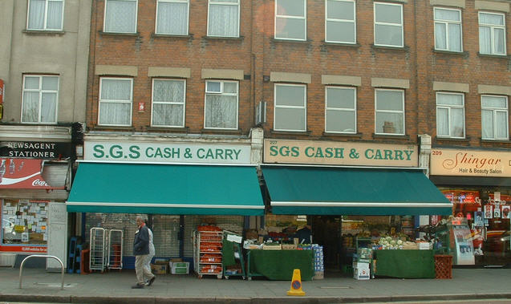
Who is more powerful?

Slide 23
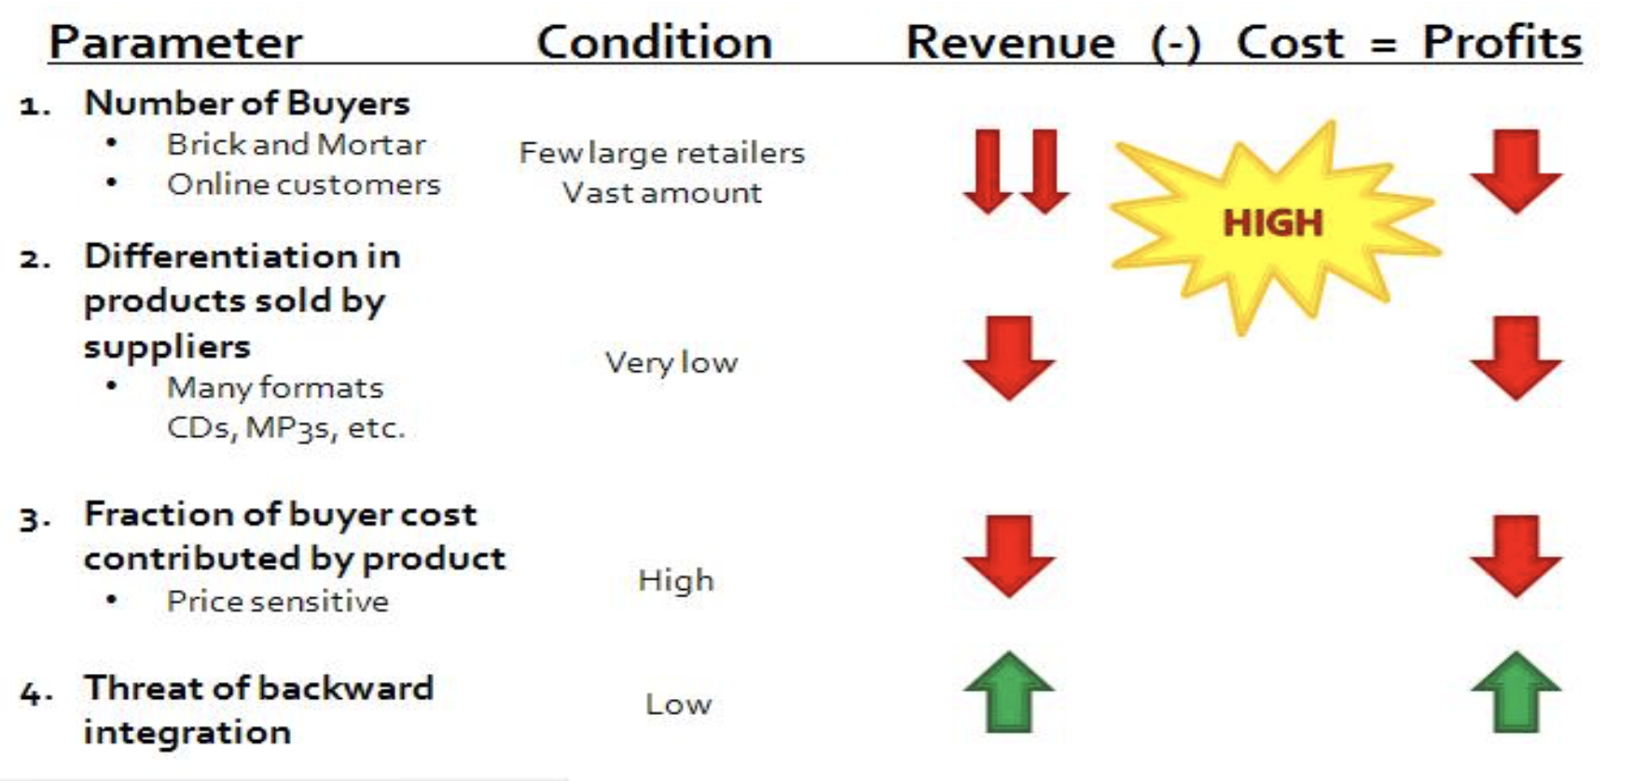
Threat of Substitutes: Music Industry
Notes:
Sources: http://schmidke330.wikidot.com/threat-of-entry
The UK is a music powerhouse, with exports of £2.5bn last year
Barriers to entry include:
Brand loyalty: Customers in the industry show a strong preference for the products and/or services of existing companies.
Cost advantages: Existing companies can easily produce and offer its products and/or services at a lower cost/price than that of new entrants.
Government regulations
Capital requirement: A high fixed cost to enter into an industry, i.e. telecommunications.
Access to suppliers and distribution channels: Existing companies own exclusive rights to suppliers and distribution channels.
Retaliation: Existing companies may collude and deter new entrants.

Slide 24
The power of Suppliers
High when….
Concentrated suppliers
High switching costs
The offer unique or scarce resources
Supplier competition threat
Forward vertical integration,
moving up closer to the ultimate customer.
Low buyer profit and impact on quality
The industry is not a key customer group to the suppliers
Notes:
Online booking make it easier for supplier to negotiate contract
brand manufacturers threatening to set up their own retail outlets)
The industry is not a key customer group to the suppliers
There are many buyers and few dominant suppliers - The offer unique or scarce resources with high switching costs - Suppliers threaten to integrate forward into the industry (e.g. brand manufacturers threatening to set up their own retail outlets) - Buyers do not threaten to integrate backwards into supply - The industry is not a key customer group to the suppliers

Slide 25
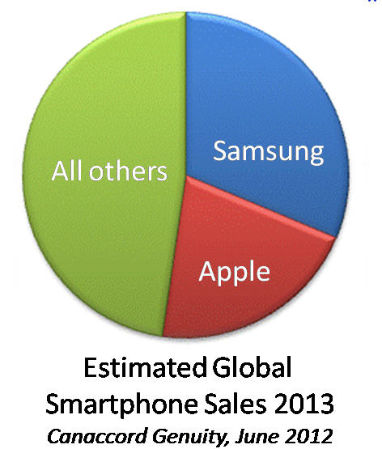
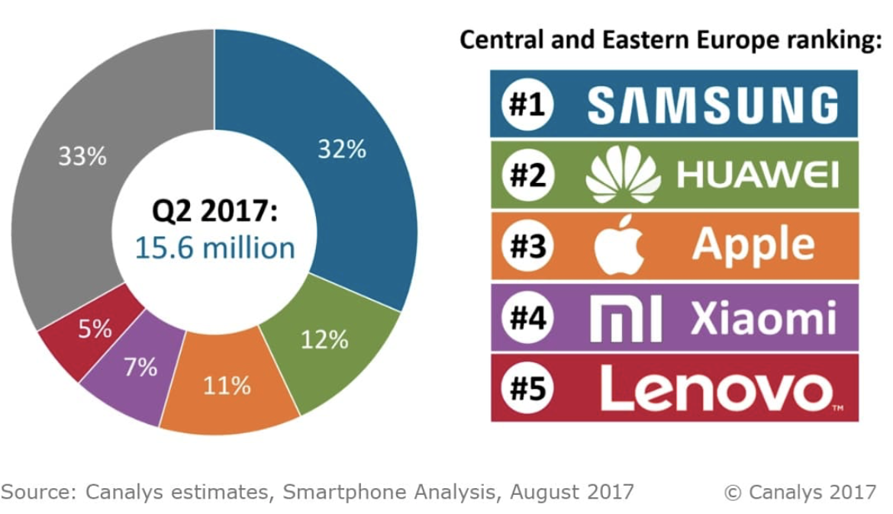
Competitive rivalry
The structure of competition - for example, rivalry is more intense where there are many small or equally sized competitors; rivalry is less when an industry has a clear market leader - The maturity of the industry, a lack of growth will lead to a ‘shakeout’

Slide 26
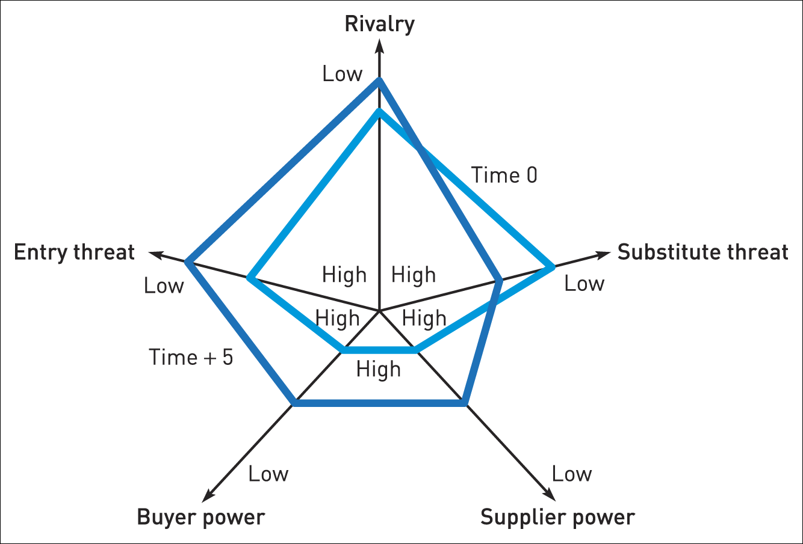
Comparative industry structure analysis

Slide 27
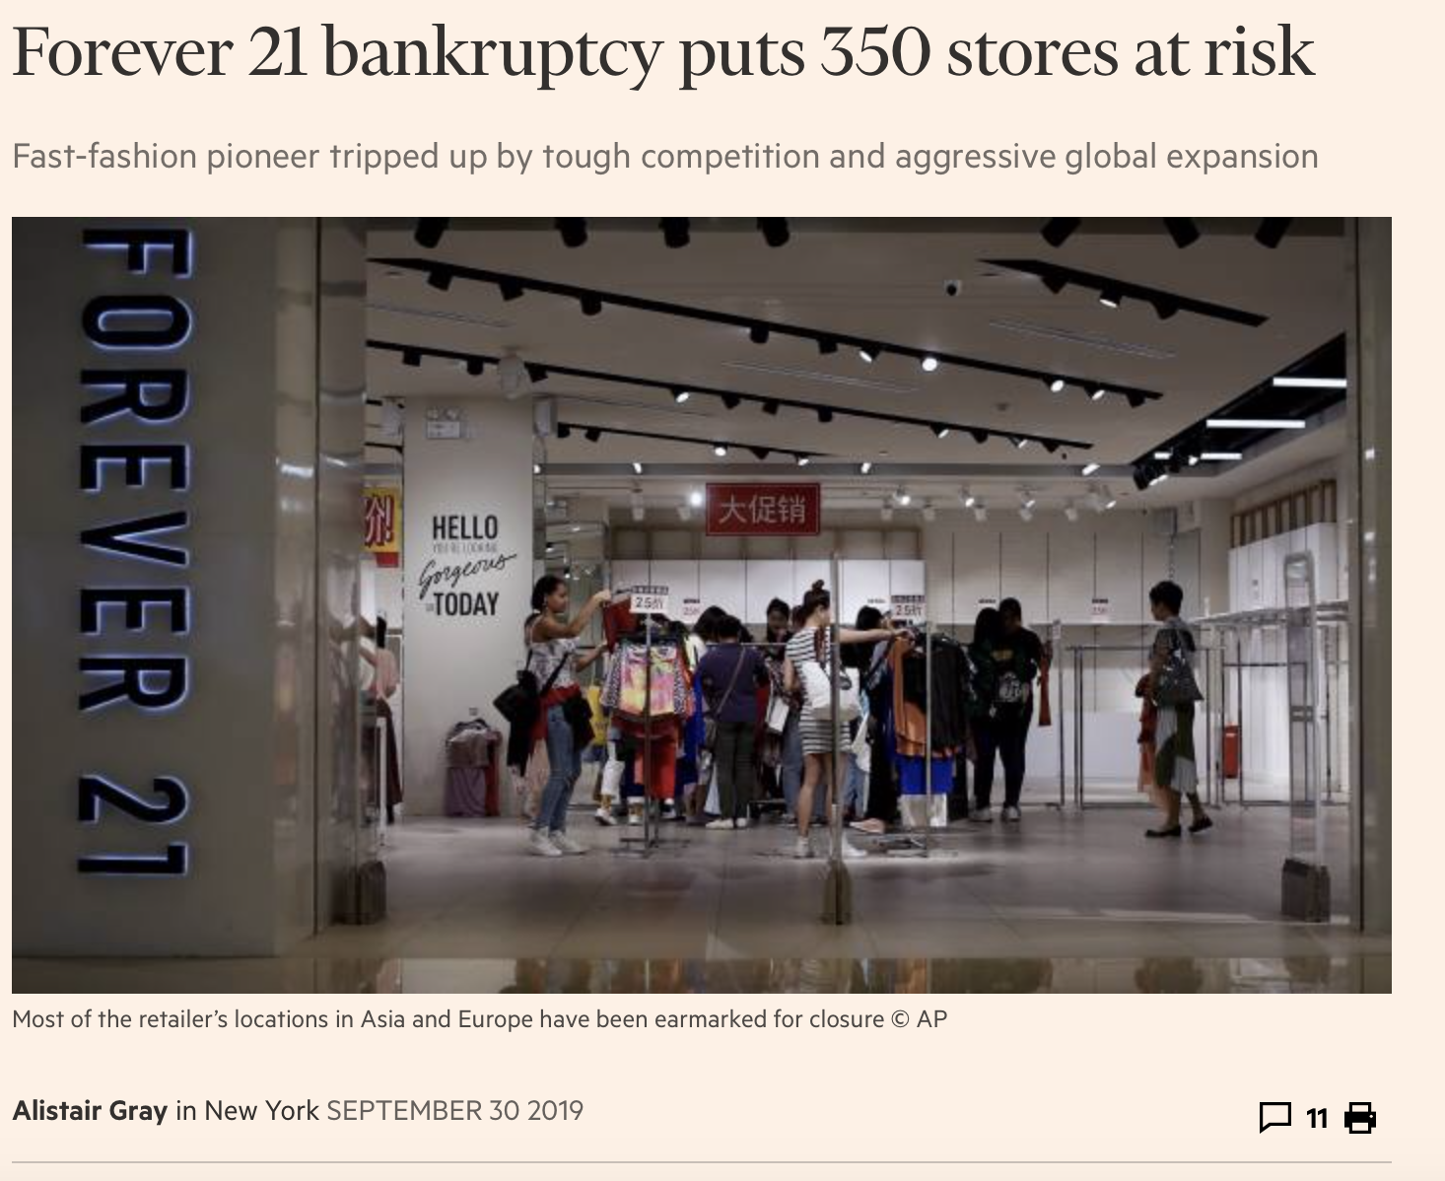
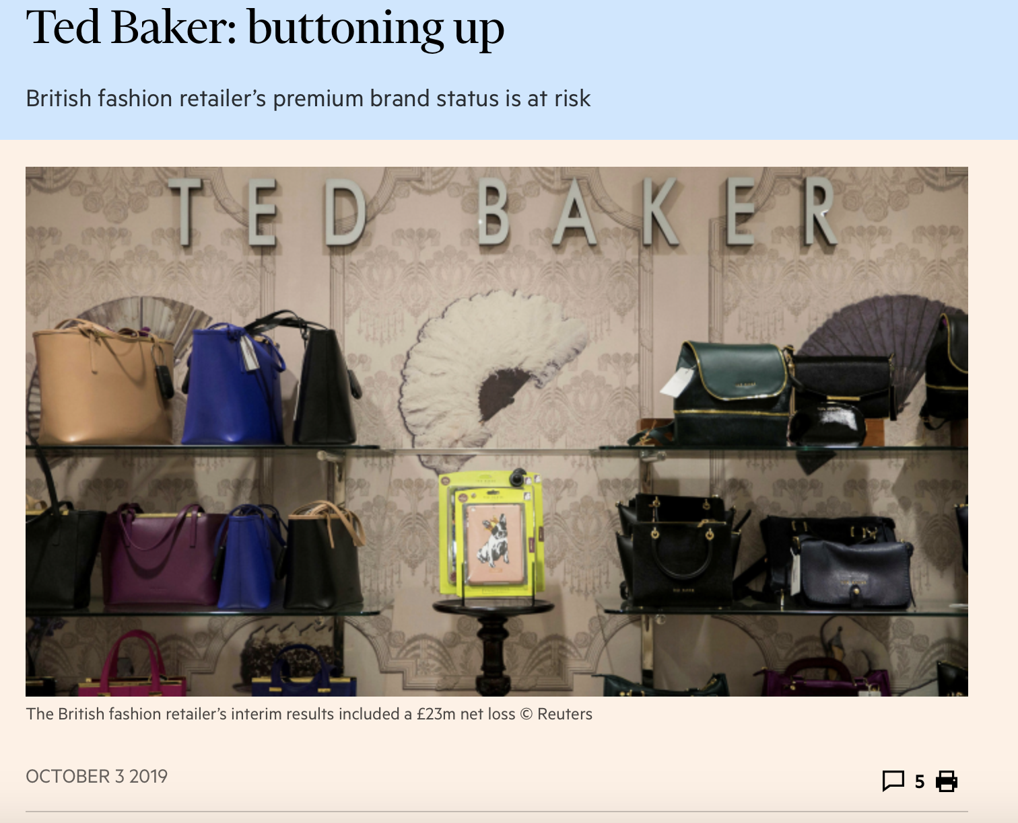
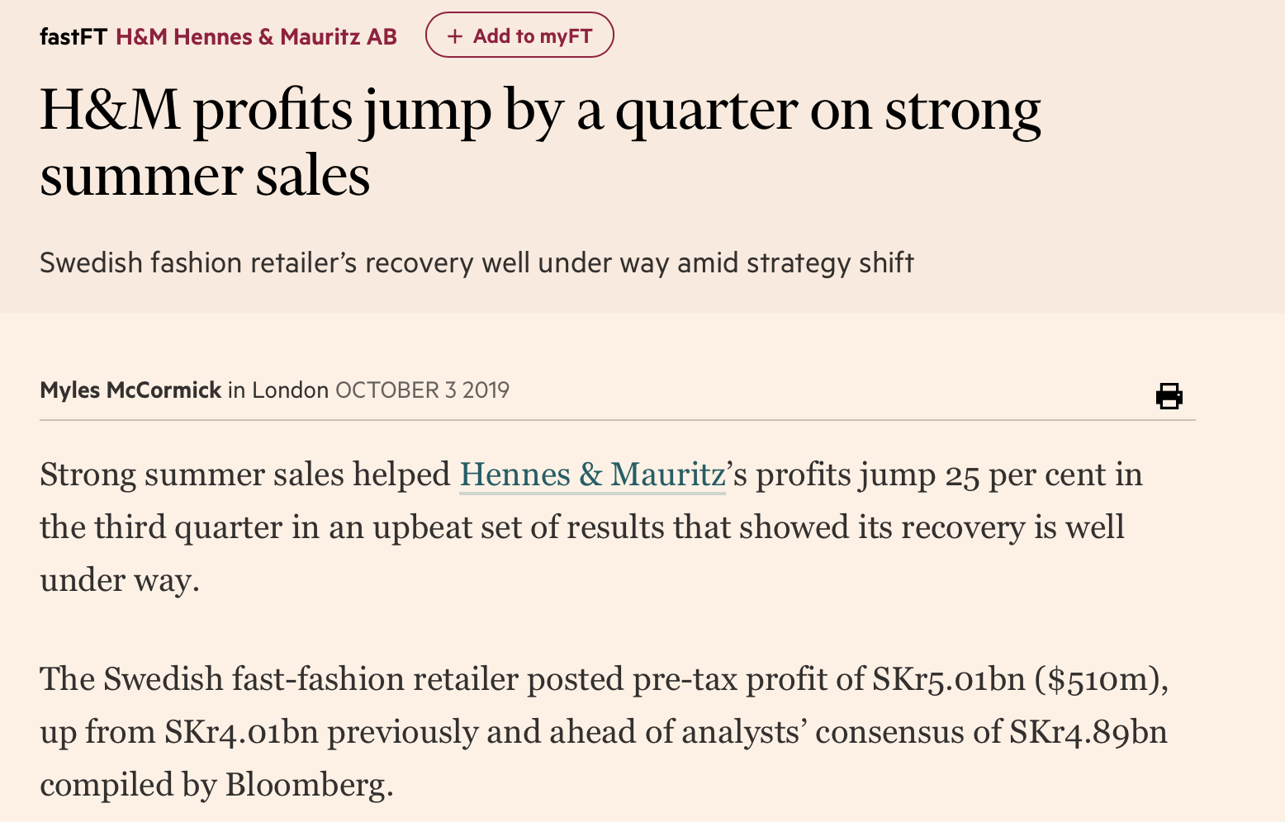

Slide 28
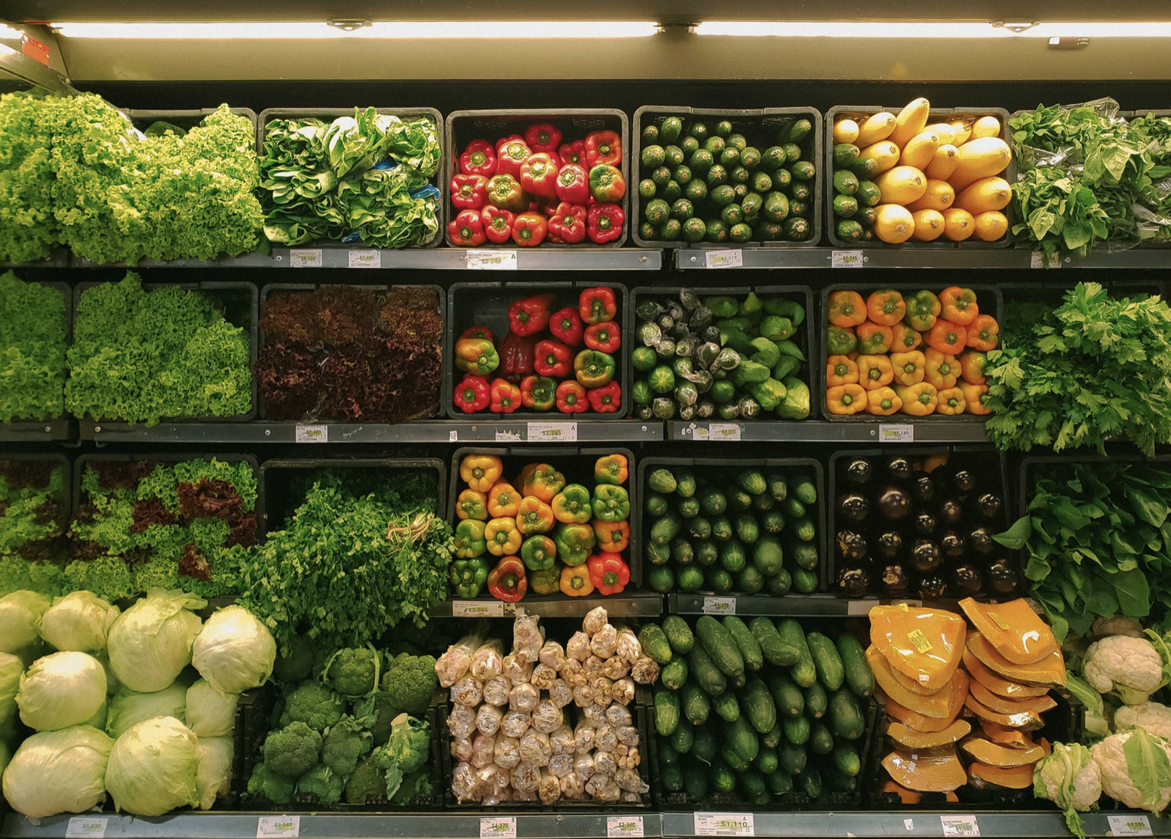
Value capture 2: Classic positioning

Slide 29
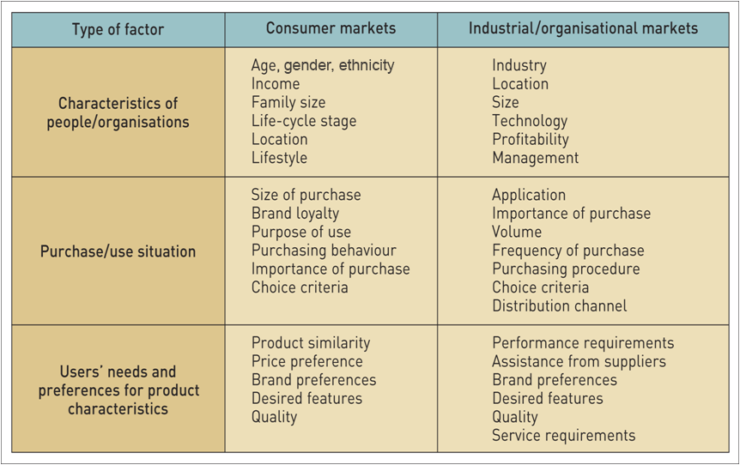
Bases of market segmentation

Slide 30
What Market Positions Do Rivals Occupy?
One technique to reveal different competitive positions of industry rivals is strategic group mapping
A strategic group is a cluster of firms in an industry with similar competitive approaches and market positions

Slide 31
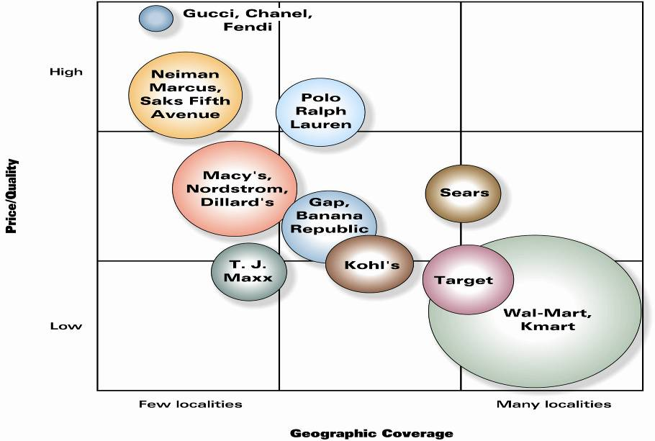
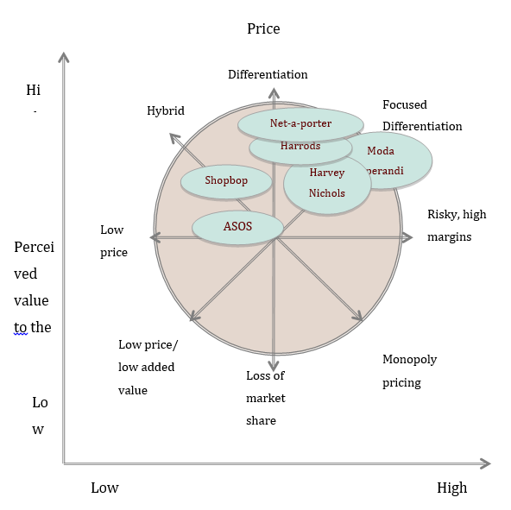
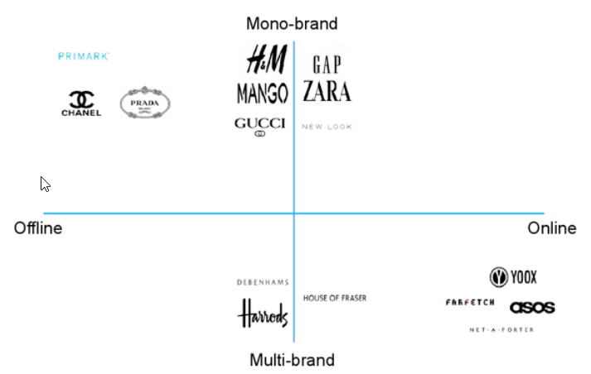
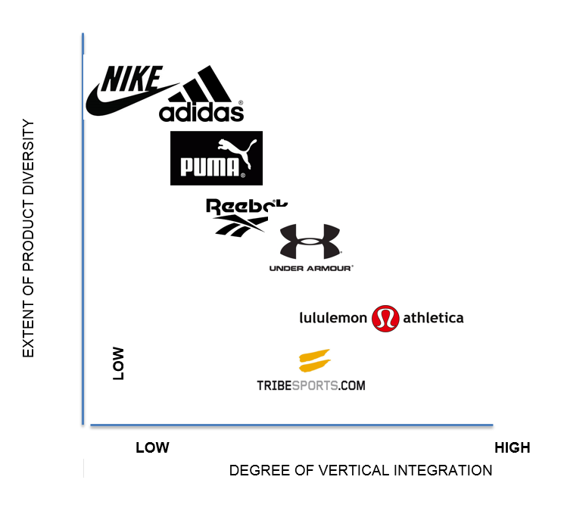
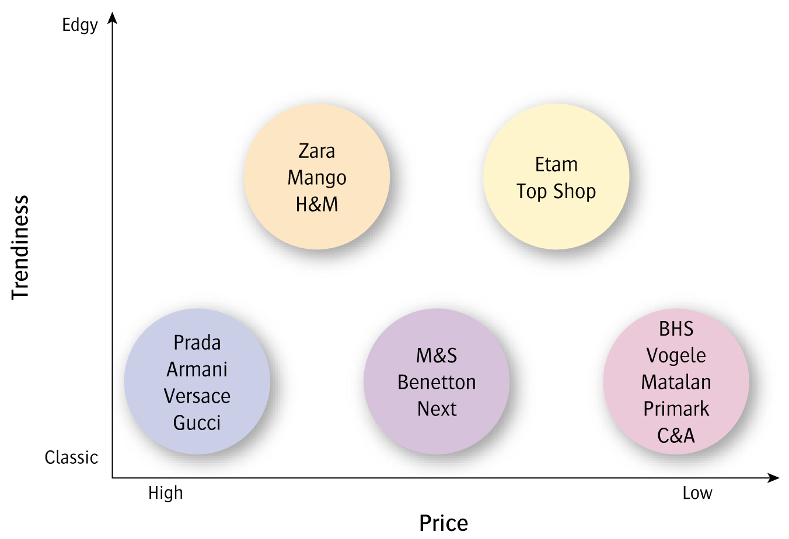
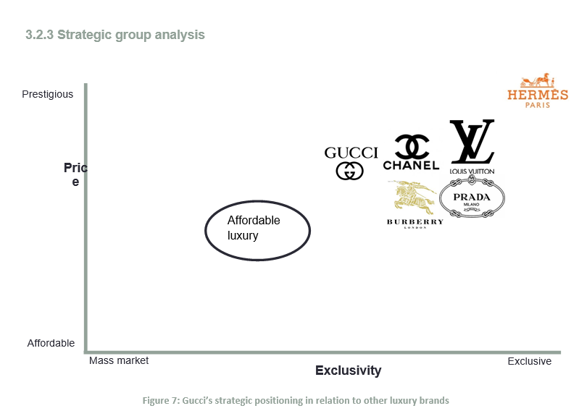
Strategic Group: Fashion Industry
D'Aveni, R. A. (2007). Mapping your competitive position. Harvard business review, 85(11), 110-20.
https://hbr.org/2007/11/mapping-your-competitive-position

Slide 32
Strategic group analysis: Price vs Geographic Coverage

Slide 33
Strategic group analysis: Trendiness vs Price

Slide 34
Strategic group analysis: Price vs Market Segment
High
Prada
Gucci
Versace
M&S
Saks
Macy
Price/
Quality
Gap
Benetton
Zara
H&M
Matalan
Primark
C&A
Wal*Mart
Tesco
Low
Few
Many
Number of Market Segments Served

Slide 35
Strategic group analysis: Product Diversity vs Vertical Integration

Slide 36
Strategic group analysis: Luxury Brand–
Prestigious vs Exclusivity
Gucci’s strategic positioning in relation to other luxury brands

Slide 37
Strategic group analysis: Multibrand vs Monobrand

Slide 38
Strategic group analysis: Price vs Market Share

Slide 39
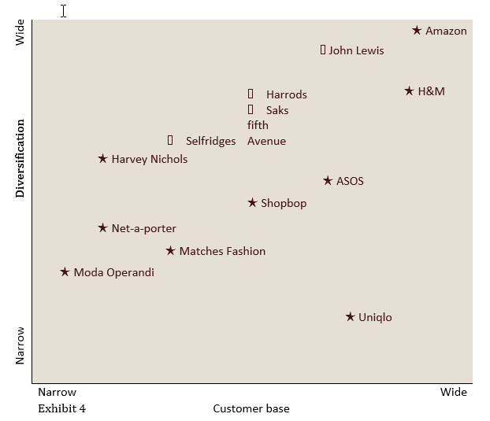
Strategic group analysis: Diversification vs Customer Base

Slide 40
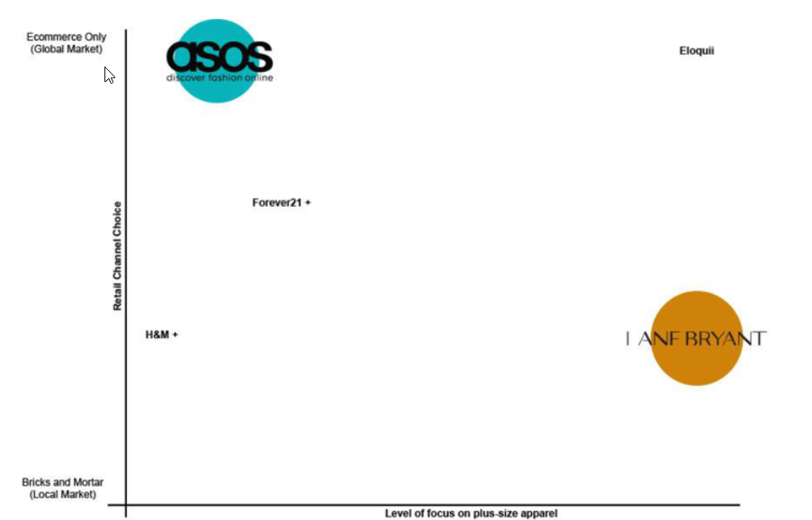
Strategic group analysis: Plus size apparel vs Retail Channel Choice

Slide 41
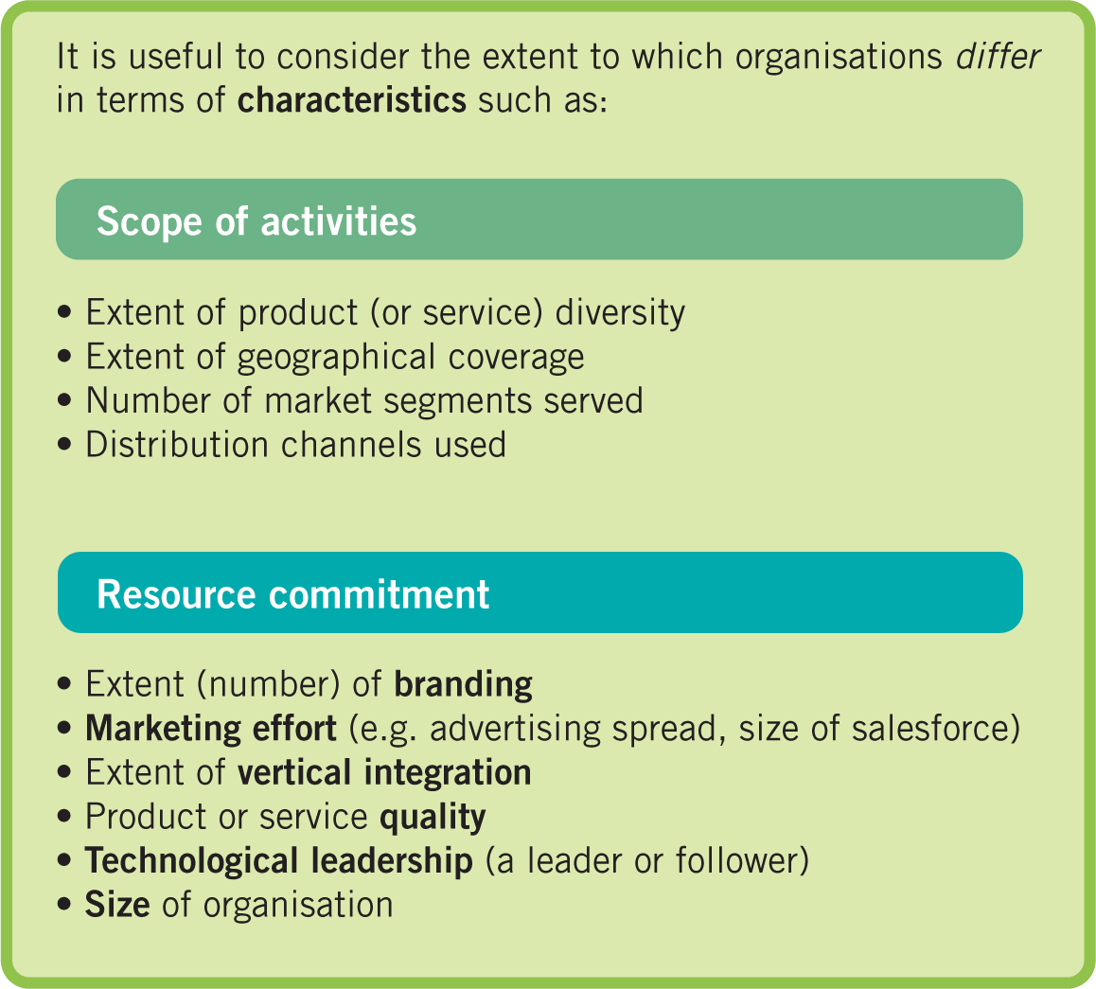
Some characteristics for identifying strategic groups
Notes:
Figure 3.6 Some characteristics for identifying strategic groups

Slide 42

Other issues to consider…
Managerial Implication
Which industries should we enter or leave?
What influence can we exert?
How are competitors differently affected?
Define the ‘right’ industry
Determine whether industries are converging
Identify complementary products
Notes:
A pipeline is a business that employs a step-by-step arrangement for creating and transferring value, with producers at one end and consumers at the other. A firm first designs a product or service. Then the product is manufactured and offered for sale. Or a system is put in place to deliver a service. It is a linear value chain.

Slide 43

Macro-environment
Scenario planning
Micro-environment
5-forces
Strategic groups
Internal environment
Value chain
Strategic capabilities-VRIN
PESTLE/
STEPWISE
Notes:
Scenario planning
Strategic group: organisation within the industry with similar strategic characteristics, following similar strategies or competing on similar bases.

Slide 44

Announcement from the Student Union

Slide 45
Resource-based strategy
The resource-based view (RBV) of strategy asserts that the competitive advantage and superior performance of an organisation are explained by the distinctiveness of its capabilities.
Strategic capabilities are the capabilities of an organisation that contribute to its long-term survival or competitive advantage.
Resources are the assets that organisations have or can call upon (e.g. from partners or suppliers), that is ‘what we have’.
Competences are the ways those assets are used or deployed effectively, that is ‘what we do well’ .

Slide 46
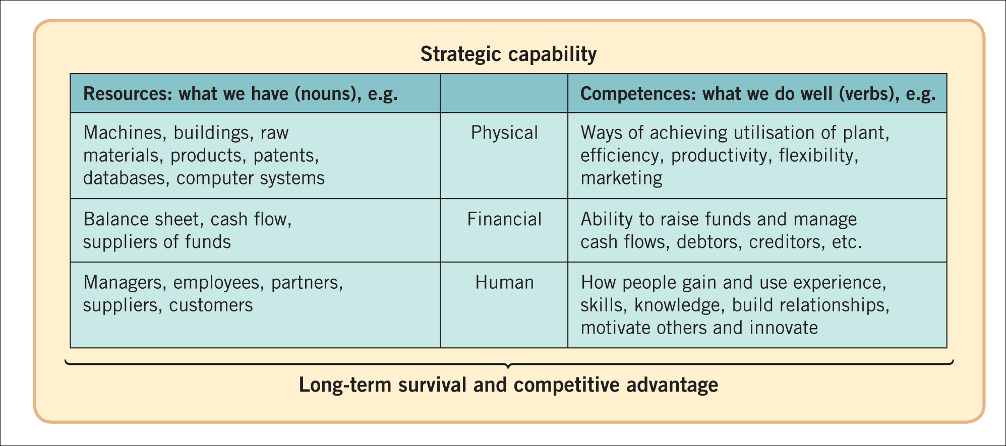
Components of strategic capabilities
Note on Redundant capabilities:
Capabilities, however effective in the past, can become less relevant as industries evolve and change.
Such ‘capabilities’ can become ‘rigidities’ that inhibit change and become a weakness.

Slide 47
Dynamic capabilities
Dynamic capabilities are the means by which an organisation has the ability to renew and recreate its strategic capabilities to meet the needs of changing environments.
Such capabilities are distinct from ordinary capabilities that may be necessary to operate efficiently now but that may not be sufficient to sustain superior performance in the future.

Slide 48

https://www.youtube.com/watch?v=MePzW82AgbQ
https://www.youtube.com/watch?v=TFDiPm4VaW0 (17 min case study)

Slide 49
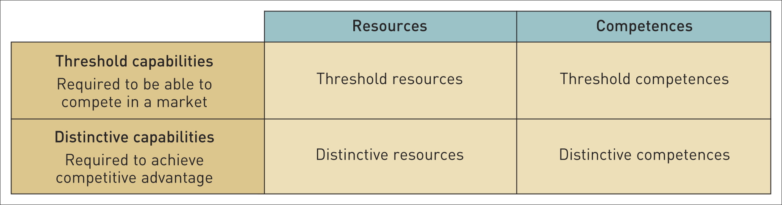
Threshold and distinctive capabilities
Threshold capabilities are those needed for an organisation to meet the necessary requirements to compete in a given market and achieve parity with competitors in that market – ‘qualifiers’.
Distinctive capabilities are those that critically underpin competitive advantage and that others cannot imitate or obtain – ‘winners’.

Slide 50
Core competences
Core competences¹ are the linked set of skills, activities and resources that, together:
deliver customer value
differentiate a business from its competitors
potentially, can be extended and developed as markets change or new opportunities arise.
¹G. Hamel and C.K. Prahalad, ‘The core competence of the corporation’, Harvard Business Review, vol. 68, no. 3 (1990),
pp. 79–91.

Slide 51
A Core competence model of the composition of Goods and Services

Slide 52
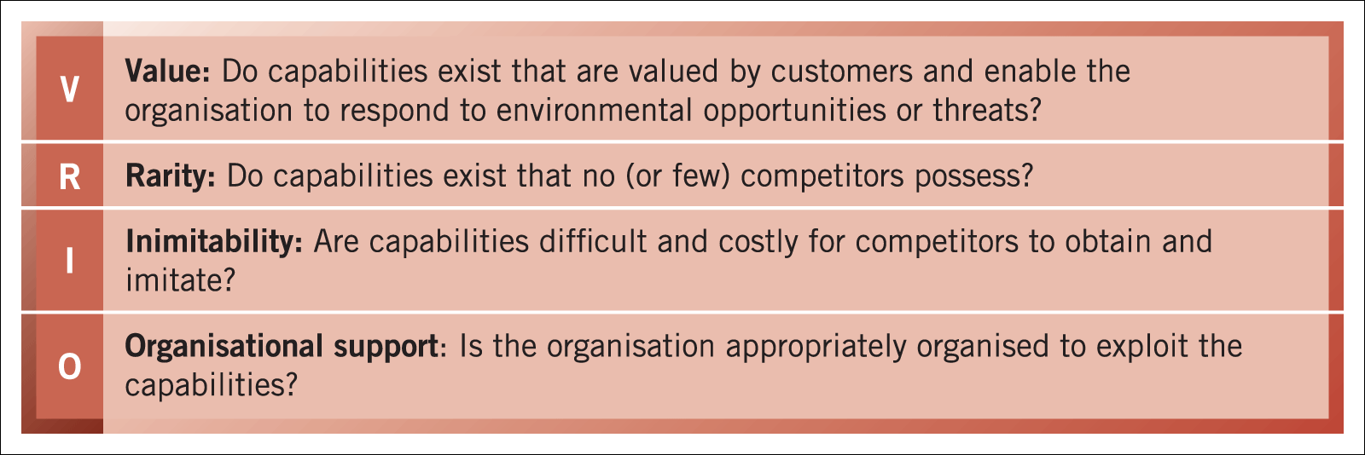
VRIO
The four key criteria by which capabilities can be assessed in terms of providing a basis for achieving sustainable competitive advantage are:
Value
Rarity
Inimitability and
Organisational support
VRIO

Slide 53
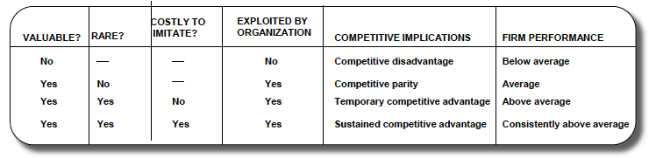
VRIO

Slide 54

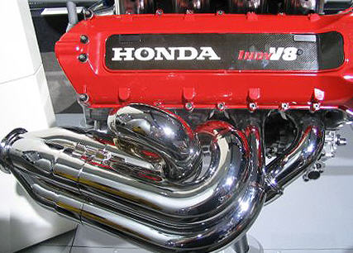
Resources, capabilities and competencies
Resources: tangible, intangible- providing value to customers and exploiting
core competencies in individual product market
Capabilities: what a firm does: internal activities: represent firm’s capacity to deploy resources that have been bundled together to achieve goal.
Core Competencies: resources and capabilities that serve as a source of
competitive advantage over rival
Make it distinct
Notes:
Competence’ gives the feeling of something ‘full’, full of the capacity to deal with the issue at hand, whereas the term ‘capability’ gives the positive feeling of ‘some space still being left’ that can be utilised to achieve the goal of any activity’
resources
competence can be defined as “a firm’s capacity to deploy its resources using processes to affect a desired end.”as “the tangible and intangible assets of a firm which can be drawn upon by the firm when required to achieve its objectives”.
capability can be defined as “the use and application of its competencies to accomplish its organizational goals.”

Slide 55
VRIO: Value of strategic capabilities
Strategic capabilities are of value when they:
take advantage of opportunities and neutralise threats,
provide value to customers
provide potential competitive advantage
at a cost that allows an organisation to realise acceptable levels of return

Slide 56
VRIO: Value of strategic capabilities
Strategic capabilities are of value when they:
take advantage of opportunities and neutralise threats,
provide value to customers
provide potential competitive advantage
at a cost that allows an organisation to realise acceptable levels of return

Slide 57
VRIO: Rarity
possessed uniquely by one organisation or by a few others only. (E.g. a company may have patented products, have supremely talented people, prime locatiuon or a powerful brand)
Rarity could be temporary.
(Eg: Patents expire, key individuals can leave or brands can be de-valued by adverse publicity.)

Slide 58
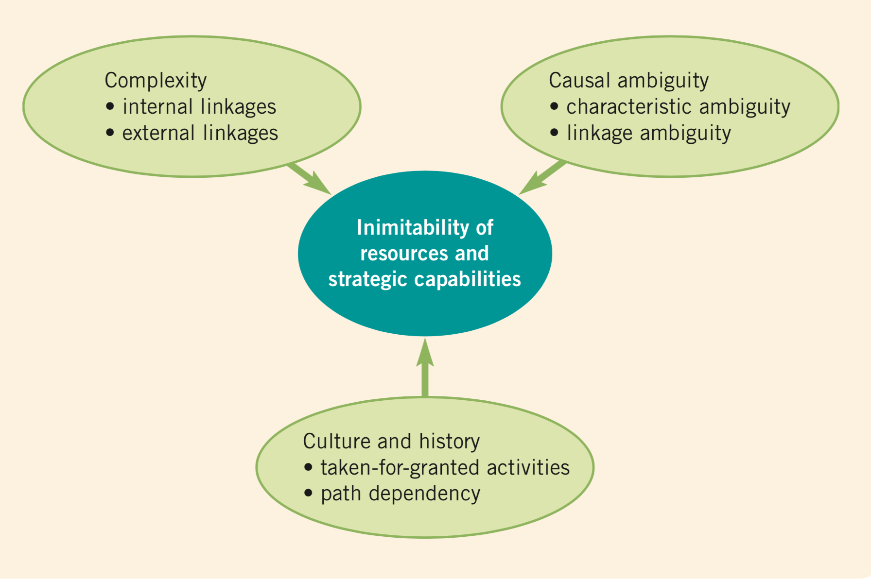
VRIO: Inimitability
Criteria for the inimitability of resources and capabilities
Sustainable advantage is more often found in competences (the way resources are managed, developed and deployed) and the way competences are linked together and integrated.
Inimitable capabilities are those that competitors find difficult to imitate or obtain. built on unique resources

Slide 59
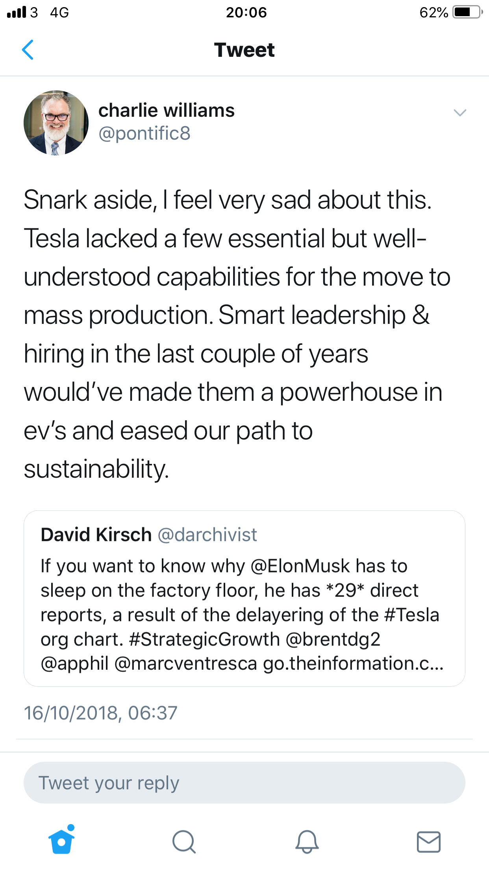
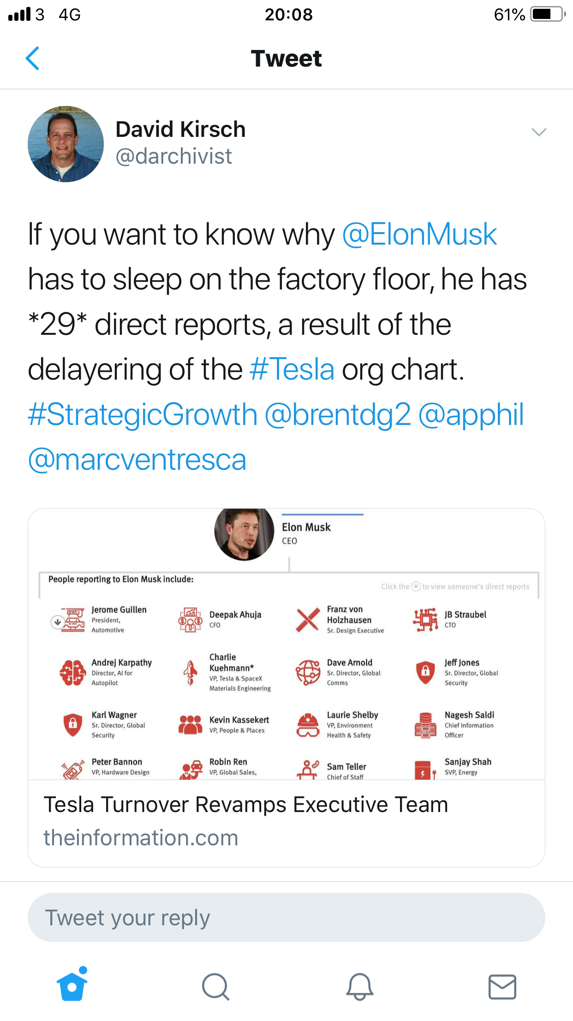

VRIO: Organisational support

Slide 60
Core competence as a strategic capability for advantage
Resources
Inputs to a firm’s production process
YES
Core competence
a strategic capability
The sources of
Capability
An integration of a bundle of resources
Does it satisfy the criteria of sustainable competitive advantage?
Capability
A non strategic bundle of resources
NO

Slide 61
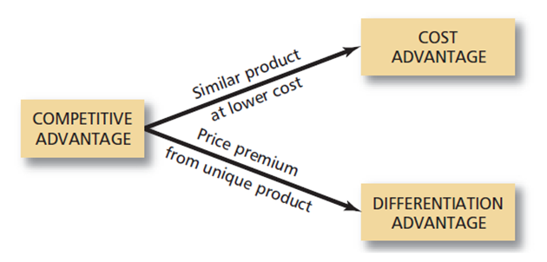
Sources of Competitive Advantage
Competitive advantage creation:
i) Sell the same product at a lower price
ii) Supply a differentiated product
Notes:
Differentiation
Provide something unique that is valuable to customers, value created exceeds the cost of the differentiation?
Differentiation is not simply about offering different product features, it is about identifying and understanding every possible interaction between the firm and its customers, and asking how these interactions can be enhanced in order to deliver additional value to customer
Cement Firm: 98% of its deliveries are on time vs 34% industry average
Amazon bookselling value added services: best-seller lists, reviews

Slide 62
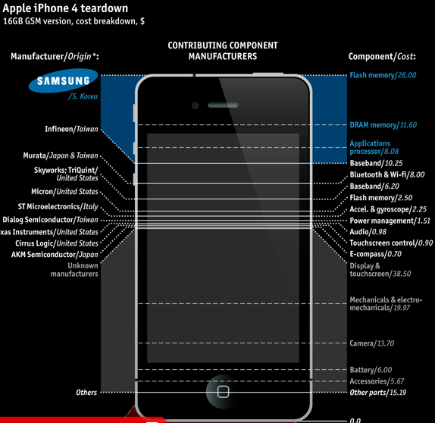
What about this? 25% of iphone 4 is samsung’s. is this open innovation?
War and piece
Notes:
five forces are high and strong, industries are not attractive.

Slide 63
Announcement from the Student Union

Slide 64
Thank you!
ainurul.rosli@brunel.ac.uk

